Slide 1
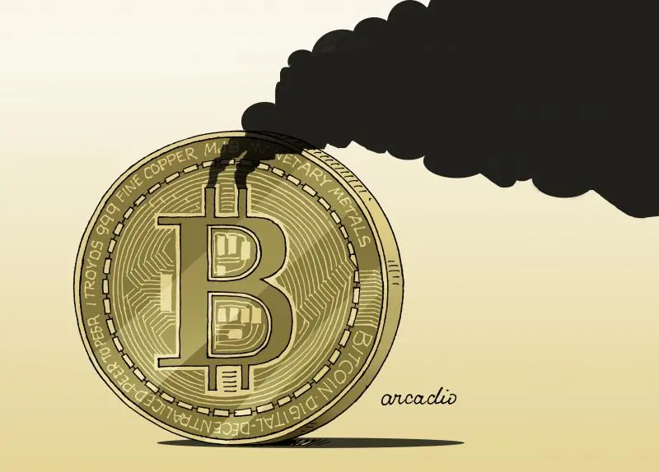
The Environmental Crossroads of Cryptocurrency: A Closer Look at Bitcoin
By
Rutwiz Gullipalli
Notes:
"Good evening everyone, we're here to present our project on 'The Environmental Crossroads of Cryptocurrency: A Closer Look at Bitcoin.' Thank you for joining us today."

Slide 2

Introduction to Bitcoin
Peer to Peer transactions – no intermediate banks.
Technology - blockchain (records transactions across a network
Notes:
Bitcoin is a revolutionary digital currency that enables peer-to-peer transactions without the need for intermediate banks. It operates on blockchain technology, which records transactions across a distributed network. This has significant implications for both the finance industry and the environment.

Slide 3
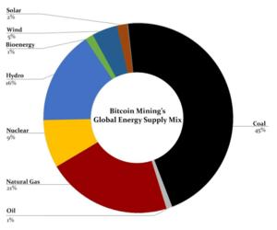
Description : Bitcoin and the environment
Energy Mix in Bitcoin Mining:
45% of Bitcoin mining energy from coal.
Renewables showing increased use.
Sustainability Outlook:
Need for greener practices.
Renewables can reduce carbon footprint.
Notes:
Moving to the environmental aspect, the majority of Bitcoin mining's energy consumption comes from coal, which is a concern. However, we're observing a promising increase in the use of renewable energy sources. The sustainability outlook suggests that greener practices are needed and that renewables have the potential to reduce Bitcoin's carbon footprint.

Slide 4
Objective
The objective of the project is to critically examine and analyze the environmental impact of Bitcoin, with a specific focus on its energy consumption and associated carbon footprint.
Access Bitcoin’s Energy consumption
Exploration of Technological Solutions
Identification of Future Research Directions
Communication of Findings
Promotion of Sustainable Practices
Notes:
Moving to the environmental aspect, the majority of Bitcoin mining's energy consumption comes from coal, which is a concern. However, we're observing a promising increase in the use of renewable energy sources. The sustainability outlook suggests that greener practices are needed and that renewables have the potential to reduce Bitcoin's carbon footprint.

Slide 5
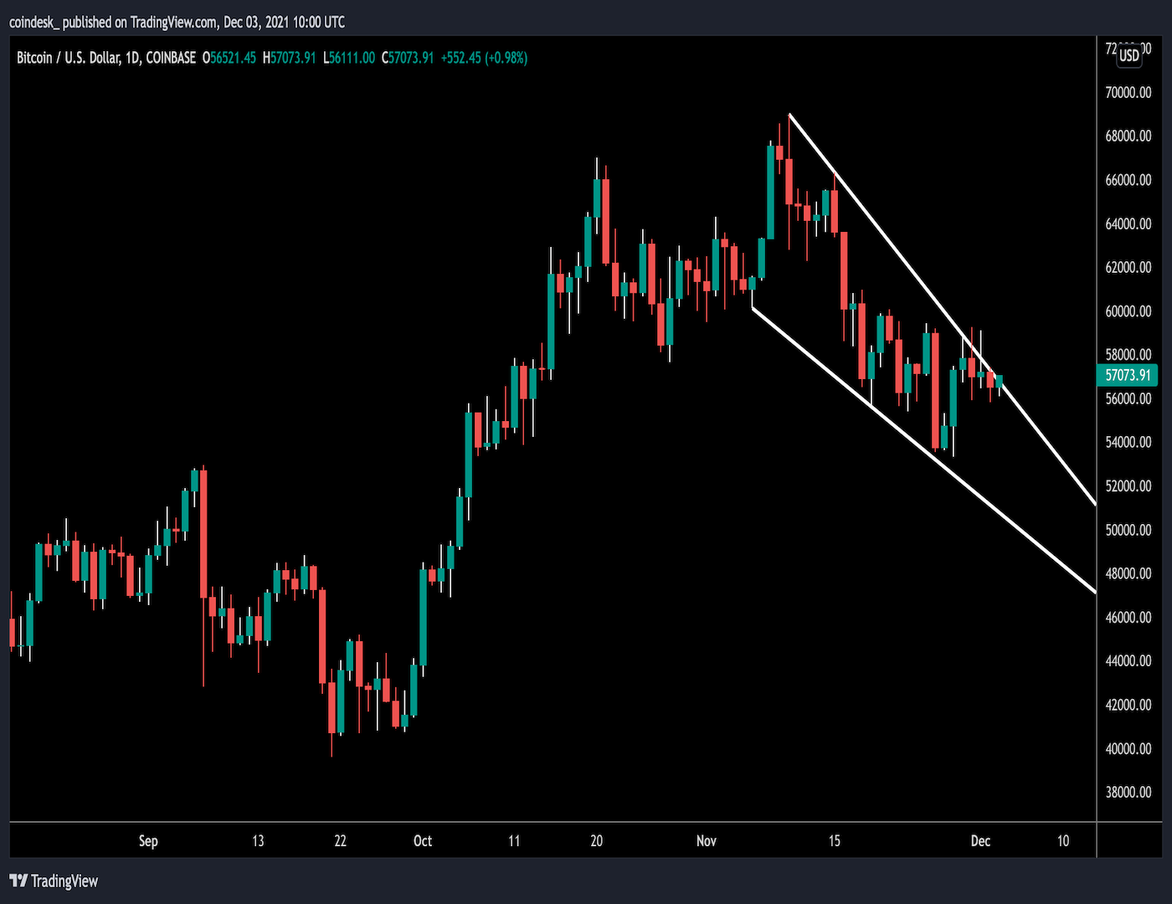
Data Overview
Dataset 1: Historical BTC Prices
Covers BTC-USD prices from April 2013 to January 2024.
Includes high, low, open, close, and volume.
Dataset 2: BTC Environmental Footprint
Tracks energy consumption and sources from 2017 to 2023.
Details on energy mix and estimated CO2 emissions.
Notes:
Our research is based on two key datasets. The first dataset includes historical BTC-USD prices ranging from April 2013 to January 2024, capturing price metrics like high, low, open, close, and volume. The second dataset tracks Bitcoin's environmental footprint from 2017 to 2023, providing insights into the energy mix and estimated CO2 emissions. Together, these datasets offer a comprehensive look at Bitcoin's market dynamics and environmental impact(Talk about all the variables).

Slide 6
Research Questions
Connecting Dots Between Market and Environment.
Null Hypothesis (H0): There is no correlation between Bitcoin's market dynamics (price, trading volume) and its environmental impact (energy consumption).
Alternative Hypothesis (H1): There is a significant correlation between Bitcoin's market dynamics (price, trading volume) and its environmental impact (energy consumption).
Notes:
Our main research question seeks to connect the dots between market and environmental factors, asking if there's a correlation between Bitcoin prices and its energy consumption. Is there a chance that what's happening with Bitcoin prices is shaking hands with how much energy it's eating up? Which parts of the Bitcoin market are moving in step with these eco-stats?
We are also curious about the parts of the Bitcoin market that correspond with environmental statistics.

Slide 7
Research Questions
The Impact of Technological Advancements and Market Trends on Bitcoin Mining Efficiency.
Null Hypothesis (H0): Technological advancements in Bitcoin mining have not led to significant improvements in energy efficiency.
Alternative Hypothesis (H1): Technological advancements in Bitcoin mining have significantly improved the energy efficiency, thereby reducing the environmental impact of Bitcoin mining.
Notes:
We're also exploring how technological advancements and market dynamics have influenced the energy efficiency of Bitcoin mining, aiming to understand the balance between economic benefits and environmental sustainability. How Have Innovations in Technology and Market Dynamics Influenced the Energy Efficiency of Bitcoin Mining?

Slide 8
Literature Review
Elharony, A. (2024, February 10). The Greening of Crypto: a revolution in the making 🌿💡🔗. https://www.linkedin.com/pulse/greening-crypto-revolution-making-amr-elharony-v6rof/
Khosravi, A., & Säämäki, F. (2023). Beyond Bitcoin: Evaluating Energy Consumption and Environmental Impact across Cryptocurrency Projects. Energies, 16(18), 6610. https://doi.org/10.3390/en16186610
Köhler, S., & Pizzol, M. (2019). Life cycle assessment of Bitcoin mining. Environmental Science & Technology, 53(23), 13598–13606. https://doi.org/10.1021/acs.est.9b05687
Sarkodıe, S. A., & Owusu, P. A. (2022). Dataset on bitcoin carbon footprint and energy consumption. Data in Brief, 42, 108252. https://doi.org/10.1016/j.dib.2022.108252
Xiao, Z., Cui, S., Xiang, L., Liu, P. J., & Zhang, H. (2023). The environmental cost of cryptocurrency: Assessing carbon emissions from bitcoin mining in China. Journal of Digital Economy, 2, 119–136. https://doi.org/10.1016/j.jdec.2023.11.001
Notes:
Trend Analysis: Studies show Bitcoin's price volatility is influenced by market demand, regulatory news, and technological advancements.
Environmental Impact: Research highlights the significant energy consumption of Bitcoin mining, raising concerns about its sustainability.
Technological Innovations: Exploration of advancements in mining technology that aim to reduce energy consumption and enhance efficiency.
Market Dynamics vs. Environmental Sustainability: Discussion on the balancing act between Bitcoin's economic incentives and environmental responsibilities.

Slide 9
Issues being handled
Analyzing Bitcoin's market volatility and energy consumption.
Assessing sustainability and carbon footprint in mining.
Innovations in mining technology for energy efficiency.
Balancing Bitcoin's growth with environmental impact.
Notes:
Market Volatility and Environmental Impact: Exploring the relationship between Bitcoin's price fluctuations, trading volumes, and its energy consumption patterns.
Sustainability of Mining Practices: Assessing how the shift towards renewable energy sources in mining operations can affect Bitcoin's overall carbon footprint.
Technological Advancements: Understanding how innovations in mining technology are contributing to energy efficiency and whether these improvements align with market trends.
Balancing Economic and Environmental Goals: Addressing the challenge of maintaining Bitcoin's growth and utility while minimizing its environmental impact.

Slide 10
Methodology
Data Analysis Techniques
Utilize statistical methods to identify correlations and trends.
Employ time-series analysis to assess changes over time.
Econometric Modelling
Explore potential causality between market dynamics and energy consumption.
Model volatility patterns in relation to trading volume and energy data.
Comparative Analysis
Compare energy mix evolution with key market indicators.
Assess the impact of external events on Bitcoin’s environmental and market metrics.
Notes:
Our methodology includes various data analysis techniques, such as statistical methods to identify correlations and trends, time-series analysis to observe changes over time, and econometric modeling to explore potential causality between market dynamics and energy consumption."

Slide 11
Potential Impacts
1.Market Implications:
Influence on investment strategies.
Impacts on regulatory policies.
2.Environmental Outcomes:
Potential for driving renewable energy adoption.
Implications for global carbon footprint reduction.
3.Technological Advancements:
Stimulating innovation in energy-efficient mining hardware.
Encouraging sustainable blockchain technology developments.
Notes:
The findings from our research have the potential to impact investment strategies and inform regulatory policies. From an environmental perspective, our study could encourage the adoption of renewable energy in mining operations and contribute to global efforts in carbon footprint reduction. Technologically, it could stimulate innovation in energy-efficient mining hardware and blockchain developments.

Slide 12
Future Directions
Continued monitoring of Bitcoin’s energy mix.
Further research on the impact of regulatory changes.
Exploration of technology’s role in reducing environmental impact.
Notes:
Looking ahead, we aim to continue monitoring Bitcoin's energy mix and investigate the impact of technological advancements and regulatory changes on its environmental footprint.

Slide 13
Questions?
Thank You
Notes:
We appreciate your attention and are now ready to take any questions you may have. Thank you.

